Slide 1
Chapter 21
Blended
Methodologies

Slide 2
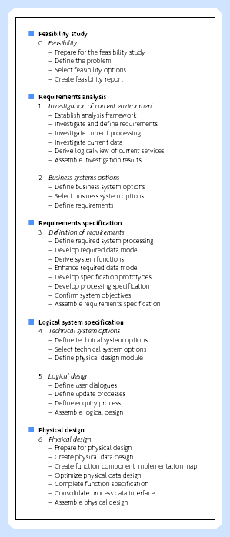
SSADM stages

Slide 3
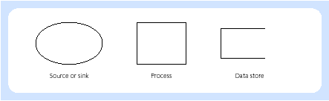
DFD symbols in SSADM

Slide 4
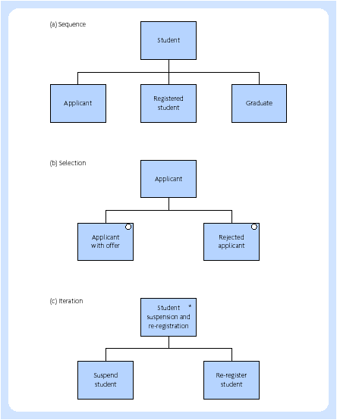
SSADM entity life history constructs

Slide 5
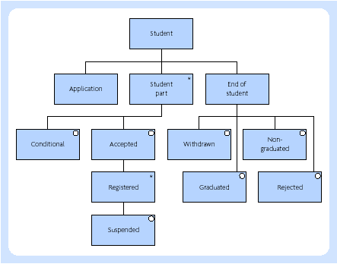
Student entity life history

Slide 6
Merise
Decision cycle
Life cycle
Abstraction cycle

Slide 7
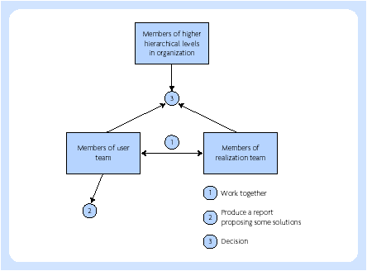
Merise: Schema of decision-making process

Slide 8
Merise life cycle
Strategic planning (at the corporate level)
Preliminary study (for the domain of interest)
Detailed study (for a particular project)
Schedules and other documentation

Slide 9
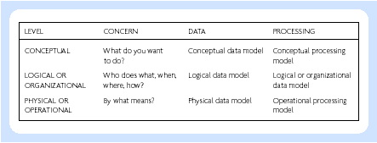
Merise by levels of data processing

Slide 10
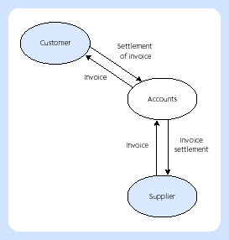
Merise flow diagram

Slide 11
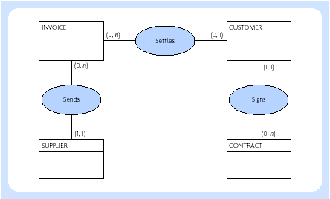
Conceptual data model (part)

Slide 12
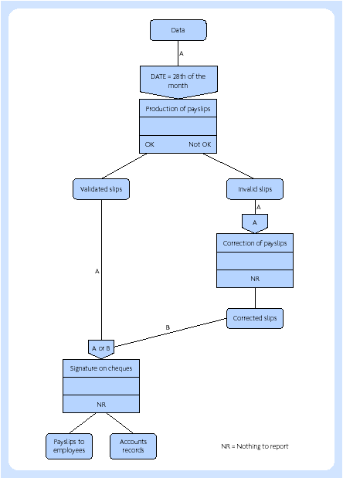
Conceptual processing model

Slide 13
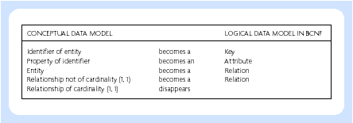
Rules of mapping conceptual processing model to normalised rational model

Slide 14
Information Engineering (IE)
Information strategy planning. The objective here is to construct an information architecture and a strategy which supports the overall objectives and needs of the organization. This is conducted at the enterprise level. One part of this planning is the identification of relevant business areas.
Business area analysis. The objective here is to understand the individual business areas and determine their system requirements.
System planning and design. The objective here is to establish the behaviour of the systems in a way that the user wants and that is achievable using technology.
Construction and cutover. The objective here is to build and implement the systems as required by the three previous levels.

Slide 15
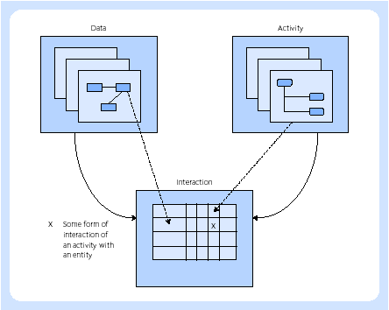
IE – data, activity and interaction

Slide 16
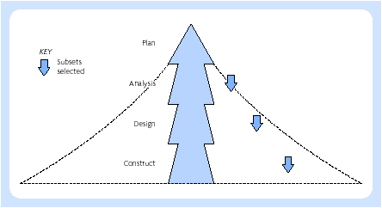
IE – divide and conquer approach

Slide 17
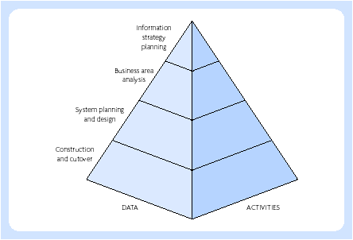
Four levels of IE

Slide 18
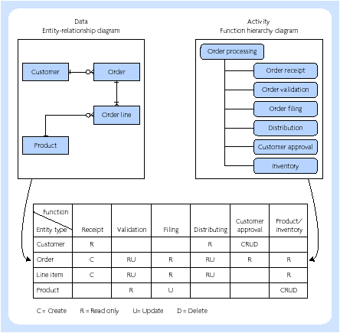
Function / entity matrix type - example

Slide 19
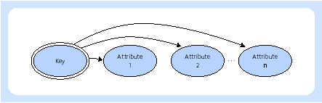
Bubble chart

Slide 20
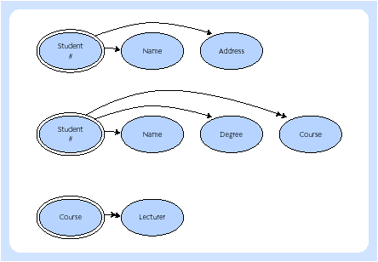
Three user views

Slide 21
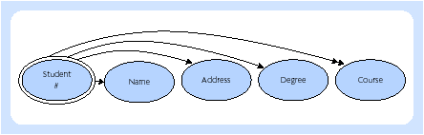
Synthises of views 1 and 2

Slide 22
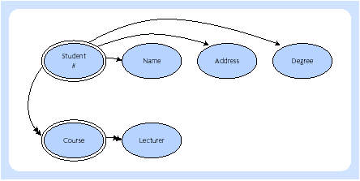
Synthises of all three views

Slide 23
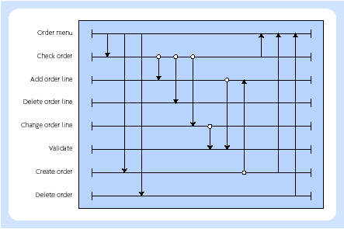
Dialogue flow example

Slide 24
Welti ERP development
Planning
Realisation
Preparation
Productive

Slide 25
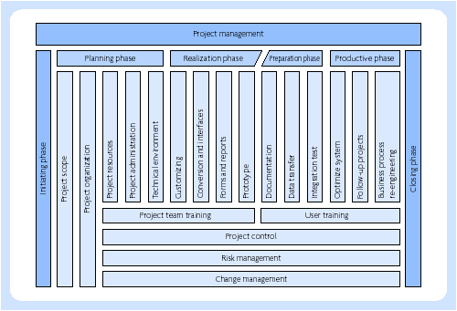
Project lifecycle – ERP development (Weiti, 1999)

Slide 26
Accelerated SAP
Project preparation. This phase sets up the project team and planning for the project.
Design business blueprint. This is an outline of the expected SAP system to be implemented.
Simulation. In this phase the design and configuration of the ERP system are completed in detail and agreed.
Validation. In this phase the planned system is implemented and tested fully.
Final preparation. In this phase the interfaces between the ERP modules are written and the system becomes operational.
Support. This refers to the ongoing maintenance and upgrading, where necessary, of the ERP system.

